Slide 1

A New Architectural Model with Data Mining Techniques for
Predicting Driver Behavior and Road Accidents
Research Scholar
  Mamidi Kiran Kumar
  Roll No: 1303PH0603
  Dept. of CSE
  JNTUH CEH, Hyderabad
Supervisor
  Dr. V. Kamakshi Prasad
  Dept. of CSE
  JNTUH CEH, Hyderabad

Slide 2
AGENDA
Motivations
Introduction
Objectives & Scope of Work
Literature Survey
Work Completed
Conclusion
Future Work to be Completed
Course work, Pre- PhD and Research Methodologies
Papers Published

Slide 3
1. Motivation
    Road accidents in Hyderabad City
    Drivers behavior in driving
    More Traffic in Hyderabad
    Importance of Smart Cities
    Got an opportunity in CoE ( Centre of Excellence) to work as a Scholar

Slide 4
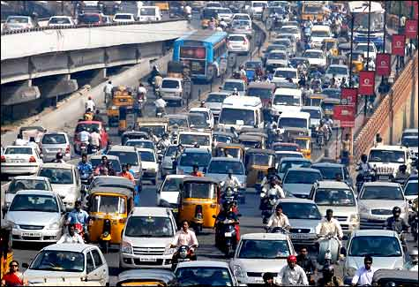
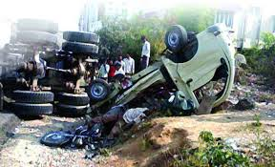
2.Introduction
Currently, in tune with economic growth in every county, the numbers of the vehicles increase every year.
Road traffic accident are a major public health concern, resulting in an estimation[WHO] 1.2 million deaths and 50 million injuries worldwide each year.
Road accidents cause injury, death, loss of property and damages to vehicles. All these involve a monetary loss to the economy.
Collected from Google

Slide 5
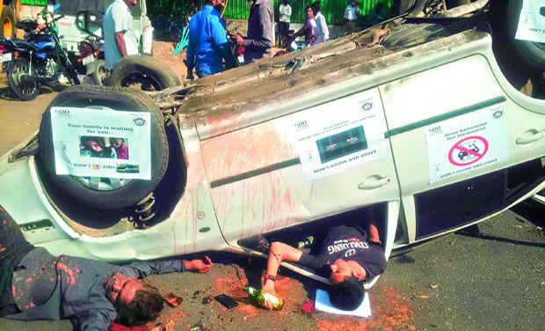
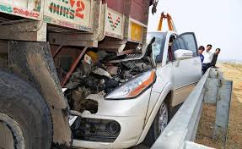
The number of non-expert drivers also increases rapidly. Since most novice drivers are unskilled, unfamiliar with the vehicle conditions and no awareness of traffic rules and regulations, drivers’ personal factors have become the main reasons of road accidents.
Understanding, analyzing and modeling human driver behavior, causes for accident in a realistic way is extremely important in enhancing the safety of the vehicles.
In a study supported by NHTSA [National Highway Traffic Safety Administration), it was found that in India, driver error was the major contributor in more than 90% of the crashes examined .

Slide 6
3. Objectives
Collect Driver behavioral data, traffic data and accident data from different sources including Hyderabad City.
Propose new architecture which suites for driver behavior , traffic and road accidents.
Identify the parameters to model the driver behavior and road accidents.
Predict the road driver behavior and road accidents by using newly developed predictive models.

Slide 7
Scope of Work
    Generate reports and alarms
      The driver driving behavior weather it is safe or not.
      Road accident’s scope in traffic conditions
      Accident prone locations and zones.
    Suggesting remedial measures to minimize/ avoid road accidents.

Slide 8
4. Literature Survey
    Traffic and Accident Parameters
    Driver Behavior Models

Slide 9
5. Work completed:
Identified a new architecture for the proposed concept
Collected traffic and accident data for Hyderabad City from Hyderabad Traffic Control Room, RTA Telangana and Ministry of Road Transport and Highways:Delhi
Explored various attributes and it’s nature in the collected data.
Explored parameters for the road accidents prediction.
Explored suitable data preprocessing models to ensure data consistency.
Explored best suitable analytical model for traffic and accident data analysis.
Identified and explored Driver Behavior Models and their Limitations.

Slide 10
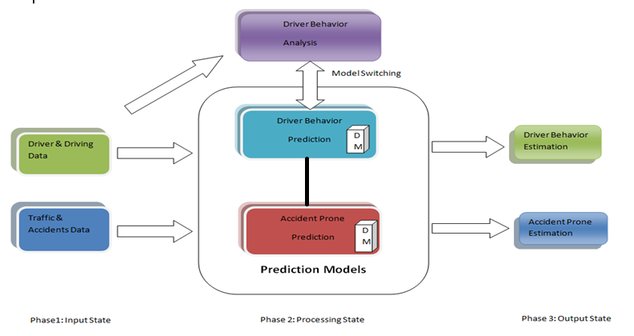
5.1. Identified a new architecture for the proposed concept

Slide 11
5.2. Collected traffic and accident data for Hyderabad City from Hyderabad Traffic Police, RTA Telangana, Ministry of Road Transport and Highways Delhi .
..\Road Trafficc & Accidents\Commissionerate Data\FIR2K15.DBF

Slide 12
5.3 . Explored suitable data preprocessing models to ensure data consistency.
Data Cleaning
  Binning Methods
    Mean , Median, Bin Boundaries
  Clustering Models
    K- Means
  Regression Models
    Linear, Multiple Linear
Data Integration & Transformation
  Schema Matching
  Correlation Analysis
    Numerical
  Normalization techniques
    Min-Max,
    Z-Score,
    Decimal Scaling

Slide 13
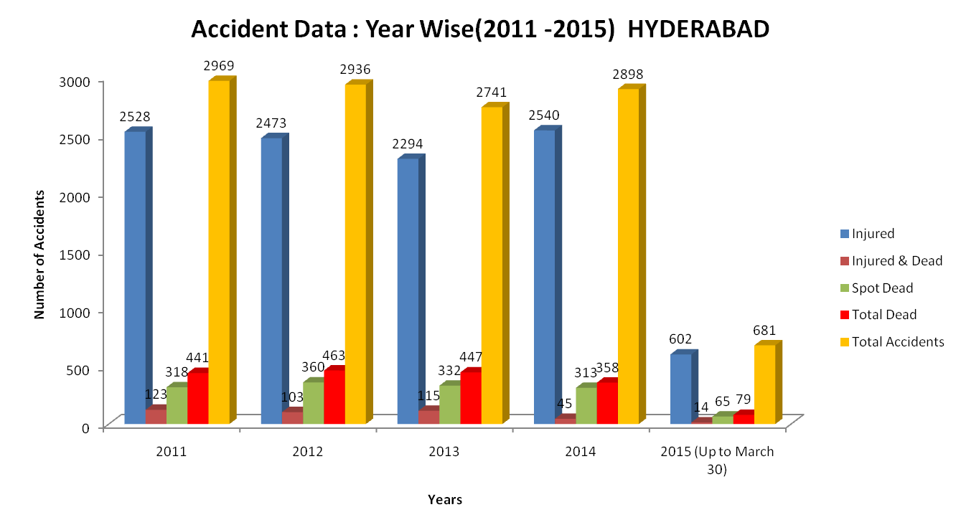

Slide 14
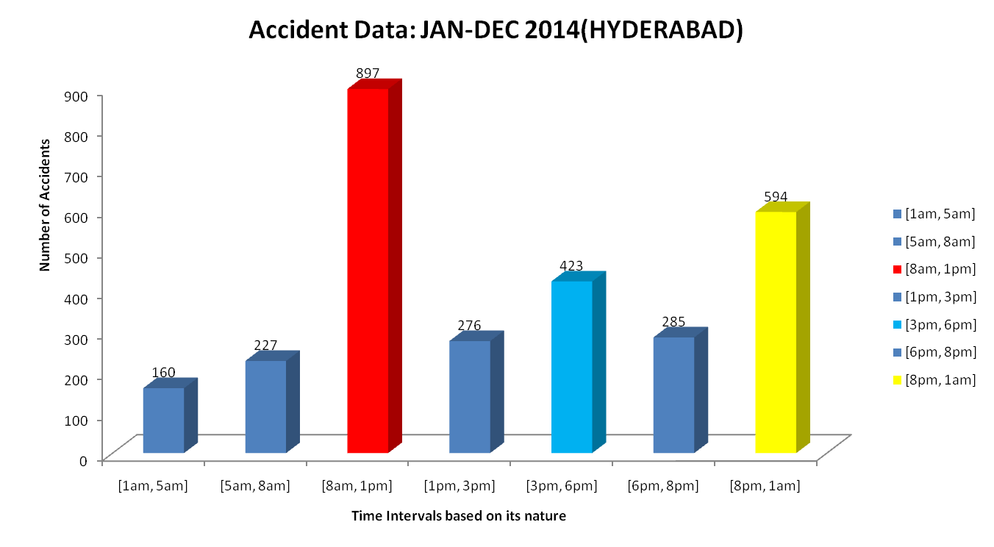

Slide 15
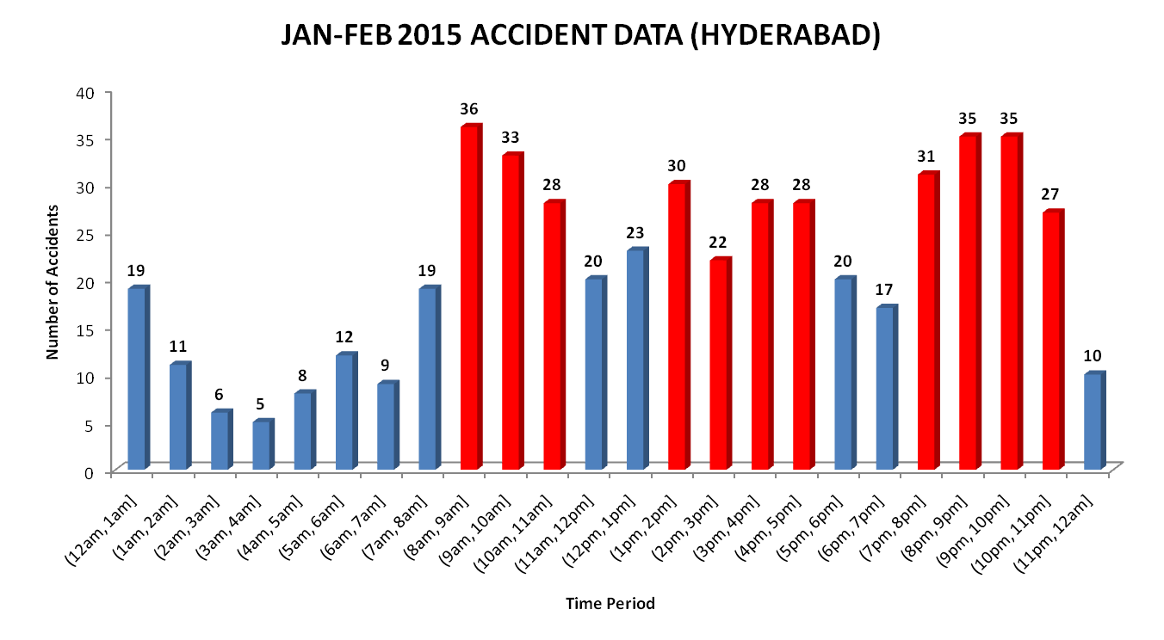

Slide 16
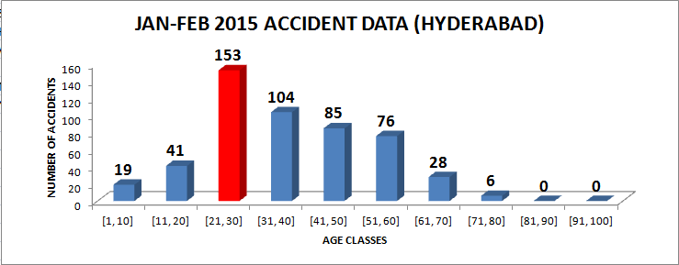

Slide 17
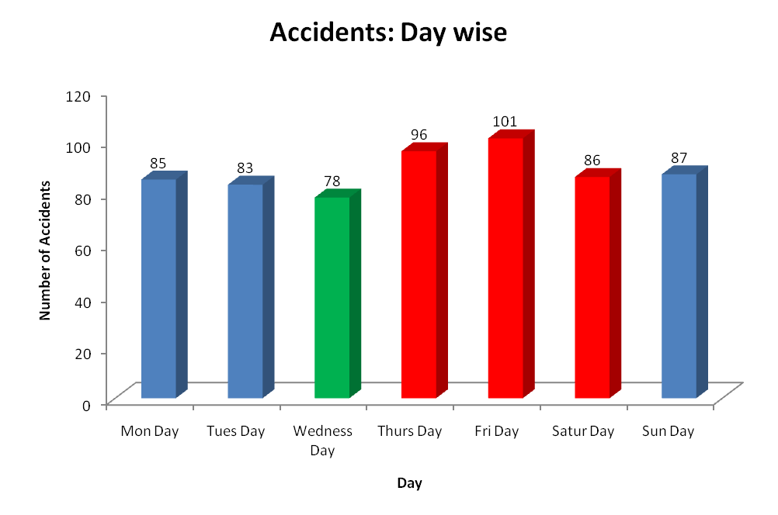
A total of 664 cases registered up to 30th March 2015

Slide 18
5.4. Explored various attributes(dimensions) and it’s nature in the collected data
S l No | Attribute | Division | Nature | Accidents Prone
1 | Time | a) 1-5 b) 5-8 c) 8-13 d)13-15 d)15- 18 e)18-20 f) 20-1 | Late morning Hours Starting Hours Business Hours Lunch Hours Business Hours Shopping Hours Late night Hours | Very Low Low Very High Low Moderate Low Very High
2 | Age | a) 1-16 b) 16-24 c) 24-50 d) 50-70 e) 70-100 | Child Teen & Young Young & Middle Middle& Old Old | Very Low High Very High Moderate Very Low
3 | Gender | Male Female | Accident Rate is High Accident Rate is Low | 1F: 4M
6 | Season | Week ends Normal Days | More prone Moderate Prone | Very High High
5 | place | T-Junction X- Roads Y- Junction 4- Junction Other | More prone More Prone Average Prone Average Prone More Prone | Very High Very High Moderate High Very High
7 | Hot Spots Areas | Major (Koti, Ameerpet,etc) Normal (East Maredpally, Vanasthalipuram, etc) Small( Medchal, Tufran), etc Other | More Prone Average Prone Less prone Less prone | Very High Moderate Low Very low

Slide 19
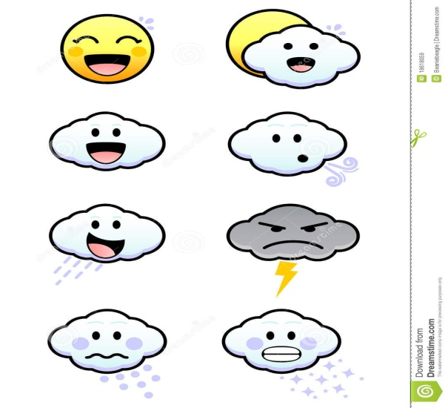
5.5. Explored parameters for the road accidents prediction
Weather
Sl No | Attributes
1 | Dusk
2 | Cloudy
3 | Rainy
4 | Sunny
Time
Sl No | Attributes
1 | Early Morning
2 | Morning
3 | Afternoon
4 | Evening
5 | Late Evening
6 | Night
7 | Late Night

Slide 20
Drivers Age
Sl No | Attributes
1 | Child
2 | Teen
3 | Young
4 | Middle age
5 | Old age
Drivers Mood
Sl No | Attributes
1 | Drunk
2 | Sleepy
3 | Aggressive
4 | Healthy
Drivers Status
Sl No | Attributes
1 | Expert
2 | Basic Expert
3 | Non Expert

Slide 21
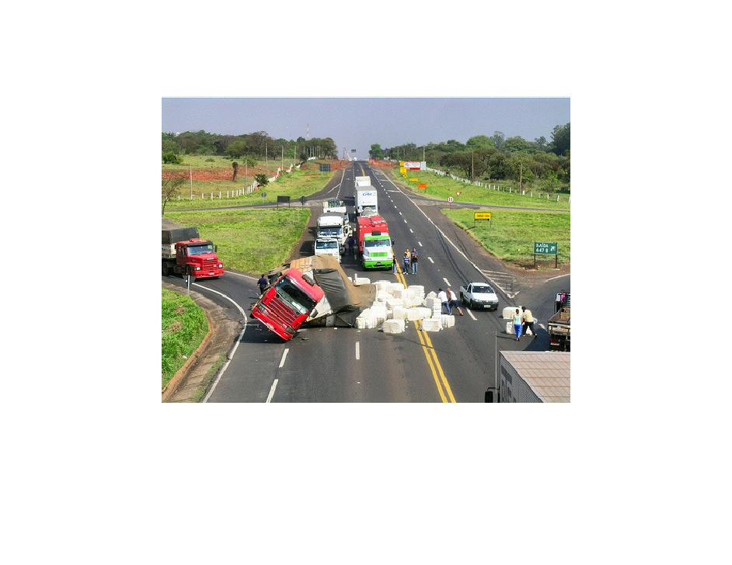
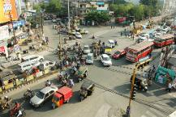
Road Nature
Sl No | Attributes
1 | Busy( More Traffic)
2 | Moderate
3 | Less
Road Type
Sl No | Attributes
1 | One Way
2 | Two Way
Junction Points on Road
Sl No | Attributes
1 | T-Junction
2 | Y- Junction
3 | 4-Junction
6 | Other Junctions ( More than 4)
Road Condition
Sl No | Attributes
1 | Fair
2 | Average
3 | Not Fair

Slide 22
Vehicle Type
Sl No | Attributes
1 | 2 Wheeler
2 | 3 Wheeler
3 | 4 Wheeler
4 | Other
Vehicle Condition
Sl No | Attributes
1 | Good
2 | Average
3 | Poor

Slide 23
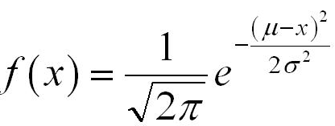
5.6. Explored suitable analytical model for traffic and accident data analysis
Normal Distribution
Example: Accident data analysis on Age attribute
    Mean= 40
    Standard Deviation= 36
    Analysis of Probability Range=20 to 60

Slide 24
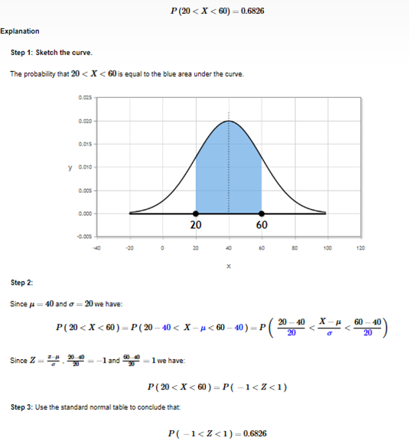
Example: Accident Data analysis on Age Parameter

Slide 25
5.7. Identified and explored Driver Behavior Models and their Limitations.
Driver Behavior Models
Driver Behavior
Analysis Models
Driver Behavior Prediction Models

Slide 26
Driver Behavior Analysis Models
1. A model Based on Vehicle OBD information and AdaBoost Algorithm
3. Driver steering Models
2. HMM based analysis Model
4. Driving Behavior Analysis System Model

Slide 27
Driver Behavior Analysis Models( Contd.)
1. A model: Based on Vehicle OBD information and Ada Boost Algorithm
Initially collect good driving data and bad driving data and convert them into good and bad data sets respectively
This model collects vehicle operation information, including vehicle speed, engine RPM, throttle position and calculated engine load via OBD(on Board detection) interface.
The method makes use of Ada Boost algorithms to create a driving behavior classification model and eventually can determine whether the current driving behavior belongs to safe driving or not .
: Shi-Huang Chen, Jeng-Shyang Pan, and Kaixuan Lu
Driving Behavior Analysis Based on Vehicle OBD Information and AdaBoost Algorithms Proceedings of the International MultiConference of Engineers and Computer Scientists I IMECS 2015 2015 18-20

Slide 28
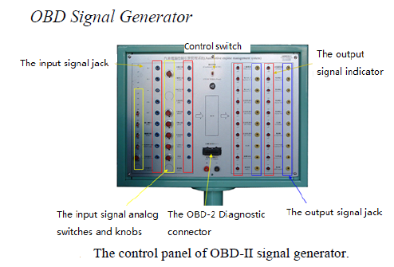
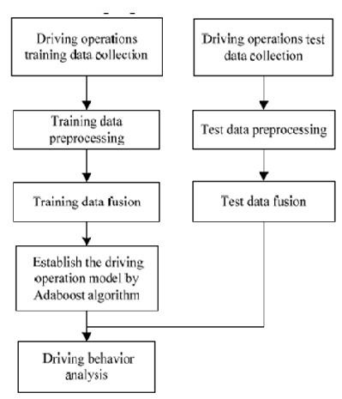
Flow Chart of this model

Slide 29
Advantages
  It make use good and bad driving data sets
  `This collects the vehicle operation information, including vehicle speed, engine RPM, throttle position, and calculated engine load from the OBD interface.
  98.96% accuracy of results
Disadvantages
  It can work only based on fixed parameters
  Computation(Training) Time is More in adaboost algorithm

Slide 30
Driver Behavior Analysis Models( Contd.)
2. HMM based analysis Model
A Driver Behavior Recognition Method using Hidden Markov Models (HMMs)
  It can characterize and detect driving maneuvers and place it in the framework of a human behavior cognitive model.
  HMMs-based steering behavior models for emergency(LCE) and normal lane changes(LCN) as well as for lane keeping (LKN) were developed using a moving base driving simulator.
  Analysis of the proposed models after training phases and recognition tests showed that driver behavior modeling and recognition of different types of lane changes is possible using HMMs.
Nobuyuki Kuge,Tomohiro Yamamura and Osamu Shimoyama, Andrew Liu
Driver Behavior Analysis Based on Bayesian Network and Multiple Classifiers
IEEE 2010 663 to 668

Slide 31
Advantages
  It detect a lane change in the very early stage of steering.
  Assure robustness
Disadvantages
  Driver simulation is a tedious job
  Training HMM using Steering (angle & Velocity) data is complex job
  Should fallow some constraints
    The average of the steering angle velocity of S3 was smaller than that of state S2, the steering angle increased with the progress of the lane change.
    The minimum absolute average values of the steering angle and steering angle velocity of each state in LKN were less than 0.003 rad and 0.008 rad/s respectively.

Slide 32
Driver Behavior Analysis Models( Contd.)
3. Driver steering Models
Driver Classification Model using PrARX(Auto Regressive with eXogenous input) modeling framework
    It is applied to describe the driver’s lateral behavior.
    The parameters of a two-mode model are identified and names are given to the modes according to the expected output from each mode.
    The model is validated on data collected on a test track using two different driving styles.
    It is used to model the steering behavior and classify the driving style of a car driver.
    The driver here is assumed to drive in two modes, corresponding to normal and aggressive driving styles, respectively
Malin Sundbom, Paolo Falcone and Jonas Sj Oberg Online Driver Behavior Classification Using Probabilistic ARX Models, Proceedings of the 16th International IEEE Annual Conference on Intelligent Transportation Systems (ITSC 2013), The Hague, The therlands,

Slide 33
Advantage
    Effectively Distinguish between two driving styles: Normal & aggressive driving
Disadvantages
    The estimation is performed with a window of 3000 samples, with a sampling time of 10 ms
    Window size is more
    Information of the coming road curve ( The path at which driver aims to follow) not included to get good results.

Slide 34
4. Driving Behavior Analysis System Model
Driver Behavior Analysis Models( Contd.)
A new driving behavior analysis system
    The hardware system combines a Driving Force Pro and two computers .
    The software system includes open source 3D engine-Speed Dreams, the Monitor program and the Data Analysis program.
    When drivers drive on this system, not only can the driving data be real-time collected and recorded, but also can the driving data be analyzed and the drivers’ operation characteristics be given out.
    The driving data is preprocessed by using data processing algorithms.
    The analyzed results include braking speed, steering speed, and response time
Yi Han, Yuan Yao, and Haiyang Liu, Design and Implementation of Driving Behavior Analysis System , Journal of Networks, Vol. 9, No. 8, August 2014 © 2014

Slide 35
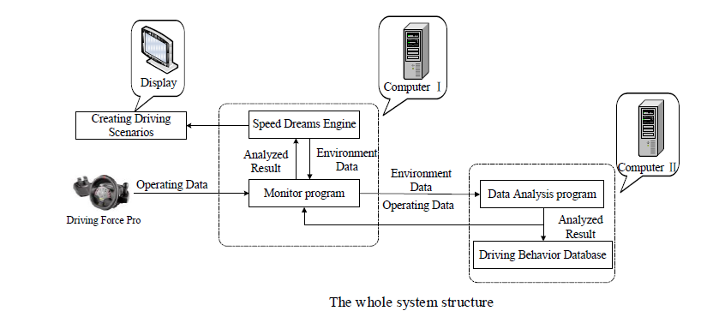
The Speed Dreams engine is used to create driving scenario
The Monitor program is used to high-speed record driving behavior
The Data Analysis program is used to real-time analyze the characteristics of driving behavior

Slide 36
Advantages
    In real-time, which can acquire the data of driving behavior.
    Which analyze the characteristics of driving behavior accurately.
Disadvantages
    Inter process communication is more

Slide 37
Driver Behavior Prediction
Driver Behavior Prediction Model
1. Probabilistic Model
4. Gap Acceptance Models
8. Collision Avoidance Models
2. Improved Driver Behavior Model
5. Lane Change Models
9. Linear Models
3. Acceleration Model:
a. Car Following Models
  GMM Model
  Neural Network Model
10. Pont Based Models
6. Dynamic Driver Behavior Model
7. Collision Models

Slide 38
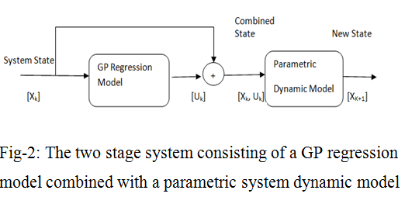
Driver Behavior Prediction( Contd.)
1. Probabilistic Model
A novel on-the-fly reduction method
    An algorithm for propagating a system state distribution through a two stage model consisting of both a GP regression model and a parametric system dynamics model.
    Two stage model is applied to the case of anticipating driver behavior and vehicle motion
Jason Hardy, Frank Havlak and Mark Campbell, Multiple-Step Prediction Using a Two Stage Gaussian Process Model, 978-1-4799-3274-0/$31.00 ©2014 AACC.

Slide 39
Sage -1
The first stage consists of driver decision making;
The driver takes as inputs information about the environment, the state of the vehicle, and internal driving goals and outputs a set of vehicle commands controlling the steering and forward acceleration of the vehicle.
This stage represents a complex, highly uncertain decision making process
It is not well modeled using parametric modeling techniques.
Stage- 2
The second stage consists of the vehicle dynamics
The driver commands are applied to the vehicle and the vehicle state is propagated forward in time.
This stage represents a known physical process and can be well modeled using a range of parametric models.

Slide 40
Advantages
    Greatly reduces the required computation time with minimal effect on accuracy.
Disadvantages
    Adaptive GMM are most effective than this model

Slide 41
Driver Behavior Prediction( Contd.)
2. Improved Driver Behavior Model
A stochastic driver behavior modeling framework
    Which takes into account both individual and general driving characteristics as one aggregate model.
    Regular patterns of individual driving styles are modeled using Dirichlet process mixture model and a non-parametric Bayesian approach.
    This frame work automatically selects the optimal number of model components to fit sparse observations of particular driver’s behavior.
    Background driving patterns are also captured with a Gaussian mixture model using a reasonably large amount of development observed data from several drivers
Pongtep Angkititrakul, Chiyomi Miyajima, Kazuya Takeda,
An Improved Driver-Behavior Model with Combined Individual and General Driving Characteristics,
2012 Intelligent Vehicles Symposium Alcalá de Henares, Spain, June 3-7, 2012

Slide 42
    By combining both the aggregate driver-dependent model,
      The probability distributions can better emphasize driving characteristics of each particular driver
      Backing off to exploit general driving behavior in cases of unmatched parameter spaces from individuals’ training observations.
    This model was employed to anticipate pedal operation behavior during car-following maneuvers

Slide 43
Advantages
    A good performance using the actually observed parameters.
Disadvantages
    It is more sensitive to the approximation errors of the input parameters.
    Only driver dynamics and Car following parameters considered.

Slide 44
Driver Behavior Prediction( Contd.)
3.1 GMM Model
Gaussian mixture model (GMM) framework for driver behavior modeling
    It allows adaptation scheme to enhance the model capability to better represent particular driving characteristics of interest from the observed driving data themselves.
    The adapted driver models showed consistent improvement over the unadapted driver models in both short-term and long-term predictions.
    Which anticipate car-following behavior in terms of pedal control operations in response to the observable driving signals such as the following distance to the leading vehicle and the own vehicle velocity.
Pongtep Angkititrakul, Chiyomi Miyajima,and Kazuya Takeda,
Modeling and Adaptation of Stochastic Driver-Behavior Model with Application to Car Following, 2011 IEEE Intelligent Vehicles Symposium (IV) Baden-Baden, Germany, June 5-9, 2011.

Slide 45
Advantages
    This two combined model emphasize a driver’s observed personalized driving styles effectively (Many common driving patterns for unseen situations)
Disadvantages
    This combined model is lose coupled model

Slide 46
Driver Behavior Prediction( Contd.)
  3. 2. Neural Network Model
Which can predict the following behavior for different lead and following vehicle-type combinations.
Performance of the model is observed and collected using data collected for six vehicle-type combinations.
A multilayer feed-forward Back propagation network(MLFF-BPN) is used to predict the vehicle-type dependent following behavior by incorporating the vehicle- type as input to this model.
The collected input is forwarded to the simulation program

Slide 47
Advantages
    Simulated speed-flow relationship from neural network model is close to the field behavior
Disadvantages
    Simulation of this model is complex task

Slide 48
4. Gap Acceptance Models
Driver Behavior Prediction( Contd.)
This model applies an algorithm of driver’s decision-making process to capture the gap acceptance behavior on the motorway.
It was difficult to observe the behavior directly from the field considering that each weaving driver has their own preferences in selection of the available gaps.
The vehicle driver may choose an available gap based on their utility
  Usually the driver chooses a highest utility.
Applying the likelihood function, it finds a beta for the utility function that maximizes the probability for choosing each available gap both in the current and target lane respectively.
Andyka KUSUMA, Ronghui LIU, Francis MONTGOMERY.
Gap Acceptance Behavior in Motorway Weaving Sections, Proceedings of the Eastern Asia Society for Transportation Studies, Vol.9,2013.

Slide 49
Advantages
    Which can distinguish required gap acceptance between heavy and small vehicles effectively
Disadvantages
    The data extraction is from Video and the data extraction techniques used in this model were very poor.

Slide 50
Driver Behavior Prediction( Contd.)
5. Lane Change Models
An integrated lane-changing model
    The model combines mandatory and discretionary considerations into a single utility model.
    The lane-changing process consists of two steps: choice of target lanes and gap acceptance decisions.
    A logit model is used to model the choice of target lanes.
    Gap acceptance behavior is modeled by comparing the available space gaps to the critical gaps.
    This model requires that both the lead and lag gaps are acceptable.
    The effect of unobserved driver or vehicle characteristics on the lane-changing process is captured by a driver specific random term.
Tomer Toledo, Haris N. and Koutsopoulos
Modeling Integrated Lane-changing Behavior , TRB 2003 Annual Meeting CD-ROM.

Slide 51
Advantages
    The model combines mandatory and discretionary considerations into a single utility model.
Disadvantages
    The model requires that both the lead and lag gaps are acceptable

Slide 52
6. Dynamic Driver Behavior Model
Driver Behavior Prediction( Contd.)
A dynamic model of the driver control strategy of lane-change behavior
    Applies it to trajectory planning in driver-assistance systems.
    This model reflects the driver control strategies of adjusting longitudinal and latitudinal acceleration during the lane-change process.
    This model can represent different driving styles by using different model parameters (driving styles such as slow, careful, sudden and aggressive).
    Here, we can analyzed the features of the dynamic model and present the methods for computing the maximum latitudinal position and arrival time.
Guoqing Xu, Li Liu, Yongsheng Ou, and Zhangjun Song,
Dynamic Modeling of Driver Control Strategy of Lane-Change Behavior and Trajectory Planning for Collision Prediction, IEEE Transactions on Intelligent Transportation Systems, Vol. 13, No. 3, September 2

Slide 53
Advantages
    The dynamic models can generate the feasible lane-change trajectories and efficiently obtain the percentage of safe trajectories by computing the minimum gap and time to collision
Disadvantages
  The lane-change trajectory planning heavily depends on high-accuracy GPSs.
  The latitudinal positions of the vehicles entirely depend on the local digital map and the DGPS receiver.
  Unsuitable for tracks with high curvatures because of the random bias for latitudinal acceleration, which the driver adjusts for lane keeping behavior.

Slide 54
Driver Behavior Prediction( Contd.)
7. Collision Models
A pro-active head restraint model
    which is a new automotive safety device with both active safety and passive safety characteristics.
    This model can make a pre-estimation of the occurrence possibility of rear-end collision.
    Establish an effective safety distance mathematical model is one of the key elements in rear-end collision avoidance system.
    The related calculation models of safety distance are established based on the running state of front car by means of dynamical and kinematical analysis of vehicle braking process and following process.
Xiaoqin Yin and Mingxia Wang,
Research on Safety Distance Mathematical Model of Pro-Active Head Restraint in Rear-end Collision Avoidance System, International Journal of Security and Its Applications Vol.9, No.1 (2015), pp.347-356

Slide 55
Advantages
    It can make a pre-estimation of the occurrence possibility of rear-end collision.
    So that, The whiplash injury can be effectively reduced or even prevented.
Disadvantages
    Did not considered the Lane Changing Parameters

Slide 56
8. Collision Avoidance Models
Driver Behavior Prediction( Contd.)
  ThiAlgorithms and experimental validation on prototype vehicles for cooperative collision avoidance at intersections based on a formal control theoretic approach.
  Algorithms for collision avoidance should have safety certificates.
  This approach can be applied where vehicles are on known crossing or merging paths
    such as at intersections or when a vehicle merges onto a road from a parking lot or on the highway.
Michael R. Hafner, Drew Cunningham, Lorenzo Caminiti, and Domitilla Del Vecchio
Cooperative Collision Avoidance at Intersections:Algorithms and Experiments,
IEEE Transactions on Intelligent Transportation Systems, Vol. 14, No. 3, September 2013.

Slide 57
Advantages
    Algorithms for evaluating the capture set and control actions are fast enough for real-time implementation.
Disadvantages
    Extend the approach to road topologies other than intersections and merges and to situations

Slide 58
  9. Linear Models
Driver Behavior Prediction( Contd.)
Modeling effort using log-linear models
This model is to estimate the relationships between driver’s fault, care­lessness and the traffic variables such as gender, accident time and accident severity.
The obtained results provide valuable information in regard to preventing undesired consequences of traffic accidents.
To determine whether there is a significant difference between the observed and expected frequencies.
H. Olmuş, S. Erbaş,
Analysis of Traffic Accidents Caused by Drivers by Using Log-Linear Models,
Human - Transport Interaction Preliminary Communication Accepted: Dec. 28, 2011 Approved: Nov. 13, 2012.

Slide 59
Advantages
    It can identify the detailed patterns of interaction between the variables in a contingency table
    Which can give value results
Disadvantages
    Which can give only 75% accurate results

Slide 60
  10. Point based Model
Driver Behavior Prediction( Contd.)
Improved Action Point Model in Traffic Flow base on Drivers’s Cognitive Mechanism
  The deduction of the acceleration equations by considering that the following car is subjected in congested traffic flow.
  The model validation and simulation results have shown that
    the improved action point car-following model can replicate car-following behavior and be able to use to reveal the essence of traffic flow characteristics.
Wuhong Wang, Wei Zhang, Dehui Li, Kiyotaka Hirahara, Katsushi Ikeuchi,
Improved Action Point Model in Traffic Flow Based on Driver’s Cognitive Mechanism
, 2004 IEEE Intelligent Vehicles Symposium,University of Parma, Parma, Italy June 1447,2004.

Slide 61
Advantages
    It give a more active realistic starting point to reveal further the essence of car following behavior than existing models.
Disadvantages
    It is not thoroughly evaluated in a relative reasonable traffic situation.

Slide 62
Proposed Architectural Model

Slide 63
Expected hybrid Models in the proposed model
HMM for Driver behavior analysis using OBD
A frame work for driver behavior prediction and based on the following models
  Dynamic driver behavior prediction model
  Adaptive GMM prediction model
  Lane Change Models
  Collision Avoidance Model ( Near, Rear end, side)
A frame work for road accident prediction using the best road accident prediction models

Slide 64
7. Conclusion
So far discussed a new architecture model, explored and identified attribute which are major cause in road accidents based on the real time data and reports and also discussed existing driver behavior models.
Suitable data analysis model is explained with an example.

Slide 65
8. Future work proposed to be completed
  To be conducted a survey on accident prediction models and identify best suitable model along with implementation.
  Explore best model to identify correlation and patterns among the accident related parameters with respected user behavior.
  Designing a new best model to predict driver and road accidents.
  Develop code for the new model.
  Conduct an experimental study on traffic and accident data using new predictive model to track/predict the road driver behavior and accidents.
  Compare the accuracy of new model by testing the model using test data.

Slide 66
9. Course work, Pre- PhD
and
Research Methodologies

Slide 67
9.1 Course Work
Sl No | Subject Code | Stream | Subject Name | Month and Year of Completion
1 | C1703 | M. Tech (DT) CSIE | Virtualization & Cloud Computing | April-2015
2 | C1706 | M. Tech (DT) CSIE | Machine Learning & Pattern Recognition | April-2015

Slide 68
9.2 Pre-PhD
Sl No | Subject Code | Paper Type | Month or Year of Registration | Subject Name | Month and Year of Completion
1 | R100604 | Paper-1 | August-2014 | Advanced Databases | December-2014
2 | R100652 | Paper-2 | August-2014 | Data Warehousing & Mining | April-2015

Slide 69
9.3 Research Methodology (RM)
Sl No | Course Name | Month or Year of Completion
1 | Research Methodology | December-2014

Slide 70
10. Papers Published
A Survey paper entitled “ Driver Behavior Analysis and Prediction Models: A Survey “ is communicated with Int. Journal: IJCSIT.
This paper has been accepted for publication in IJCSIT( May- June Volume 2015) in the Month of July last week.
Sl No | Title of the Paper | Name of the Journal | Volume No | Issue No | Month / Year | Status
1 | Driver Behavior Analysis & Prediction Models : A Survey | Int. Journal of Computer Science and Information Technology ( IJCSIT) | - | - | May-June 2015 | Accepted for Publication

Slide 71
Thank you

Slide 72
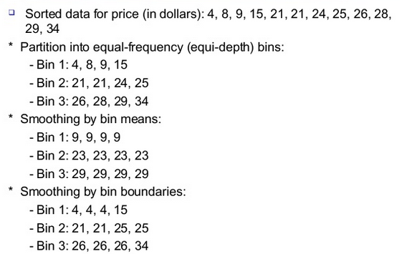
Binning Technique

Slide 73
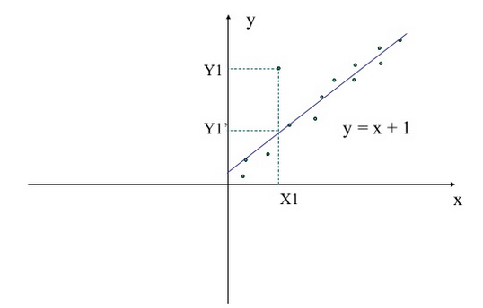
Linear Regression

Slide 74
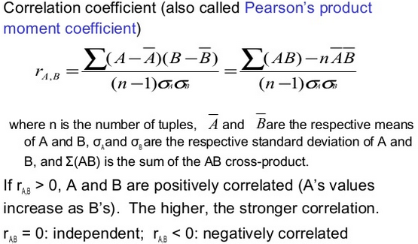
Numerical Data- Correlation Analysis

Slide 75
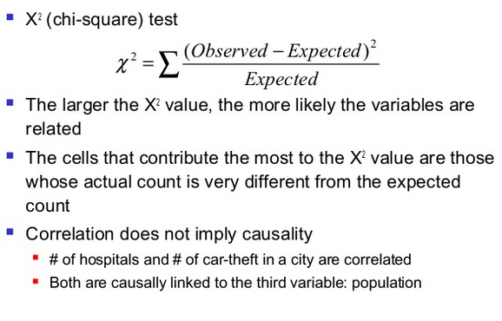
Correlation Analysis for Categorical Data

Slide 76
